Slide 1
MySQL + Hibernate
Alicja Salamon, Dawid Aksamit

Slide 2
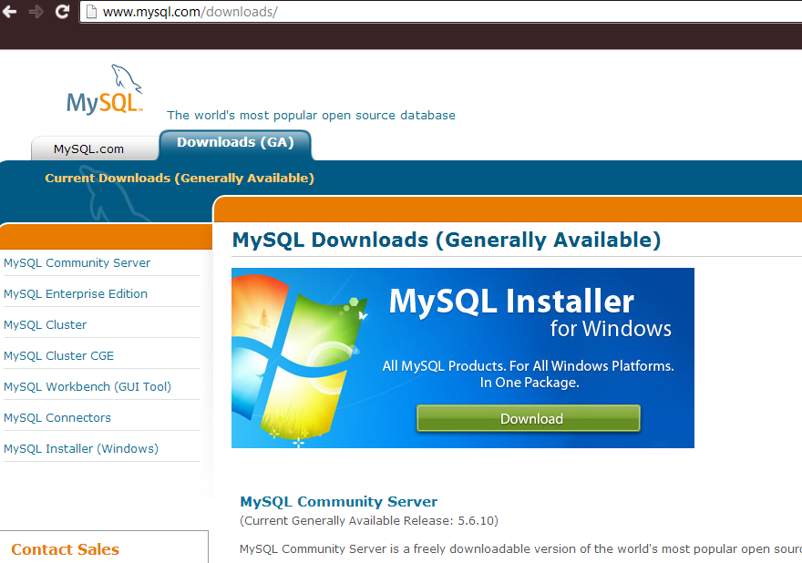
Instalacja MySQL

Slide 3
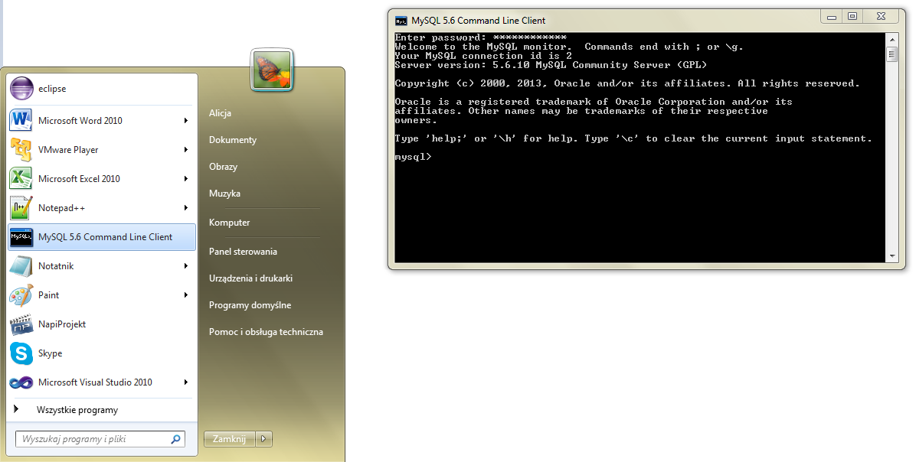
Uruchomienie

Slide 4
Tworzenie bazy danych
mysql> CREATE DATABASE northwind;
Query OK, 1 row affected (0.16 sec)
mysql> drop DATABASE nortwind;
Query OK, 0 rows affected (1.28 sec)
mysql> show databases;
+--------------------+
| Database |
+--------------------+
| information_schema |
| mysql |
| northwind |
| test |
| world |
+--------------------+
mysql> USE northwind
Database changed
mysql> show tables;
+----------------------+
| Tables_in_northwind |
+----------------------+
| categories |
| customercustomerdemo |
| customerdemographics |
| customers |
| employees |
| employeeterritories |
| orderdetails |
| orders |
| products |
| region |
| shippers |
| suppliers |
| territories |
+----------------------+

Slide 5
Tworzenie tabeli
mysql> create table Products(
ProductID int NOT NULL auto_increment,
ProductName varchar(40) NOT NULL,
SupplierID int,
CategoryID int,
QuantityPerUnit varchar(20),
UnitPrice decimal(10,4) default 0,
UnitsInStock smallint NOT NULL default 0,
UnitsOnOrder smallint NOT NULL default 0,
ReorderLevel smallint default 0,
Discounted bit(1) NOT NULL default 0,
PRIMARY KEY(ProductID),
FOREIGN KEY(SupplierID) references Suppliers(SupplierID) on delete cascade,
FOREIGN KEY(CategoryID) references Categories(CategoryID) on delete cascade
)ENGINE=InnoDB;
mysql> CREATE TABLE `Products` (
`ProductID` INTEGER NOT NULL AUTO_INCREMENT,
`ProductName` VARCHAR(40) NOT NULL,
`SupplierID` INTEGER,
`CategoryID` INTEGER,
`QuantityPerUnit` VARCHAR(20),
`UnitPrice` DECIMAL(10,4) DEFAULT 0,
`UnitsInStock` SMALLINT(2) DEFAULT 0,
`UnitsOnOrder` SMALLINT(2) DEFAULT 0,
`ReorderLevel` SMALLINT(2) DEFAULT 0,
`Discontinued` BIT NOT NULL DEFAULT 0,
CONSTRAINT `PK_Products` PRIMARY KEY (`ProductID`)
);

Slide 6
Opis tabeli
mysql> describe Products;
+-----------------+---------------+------+-----+---------+----------------+
| Field | Type | Null | Key | Default | Extra |
+-----------------+---------------+------+-----+---------+----------------+
| ProductID | int(11) | NO | PRI | NULL | auto_increment |
| ProductName | varchar(40) | NO | | NULL | |
| SupplierID | int(11) | NO | MUL | NULL | |
| CategoryID | int(11) | NO | MUL | NULL | |
| ContactName | varchar(30) | NO | | NULL | |
| QuantityPerUnit | varchar(20) | NO | | NULL | |
| UnitPrice | decimal(10,2) | NO | | NULL | |
| UnitsInStock | smallint(6) | NO | | NULL | |
| UnitsOnOrder | smallint(6) | NO | | NULL | |
| ReorderLevel | smallint(6) | YES | | NULL | |
| Discounted | bit(1) | NO | | NULL | |
+-----------------+---------------+------+-----+---------+----------------+

Slide 7
Dodawanie danych

Slide 8
Hibernate

